Slide 1
Fuel Up to Play with Let’s Move; Active Schools
Tara Griffin – Hall of Fame KS Program Advisor 2014-15
Wendy Scholten – Fuel Up to Play 60Head Coach
Notes:
Tell who we are and what we do

Slide 2
Show how Fuel Up to Play 60 and Let’s Move Active Schools can go hand in hand with each other.
Fuel Up to Play with Let’s Move; Active Schools
Today’s Goal
Notes:
Wendy Read slide

Slide 3
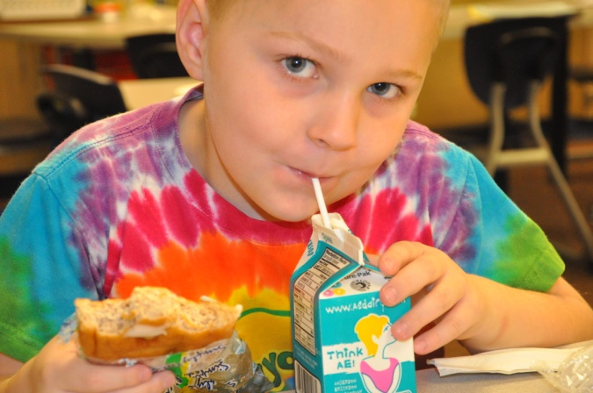
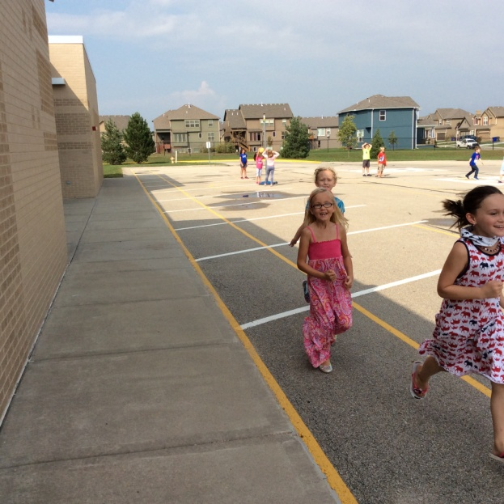
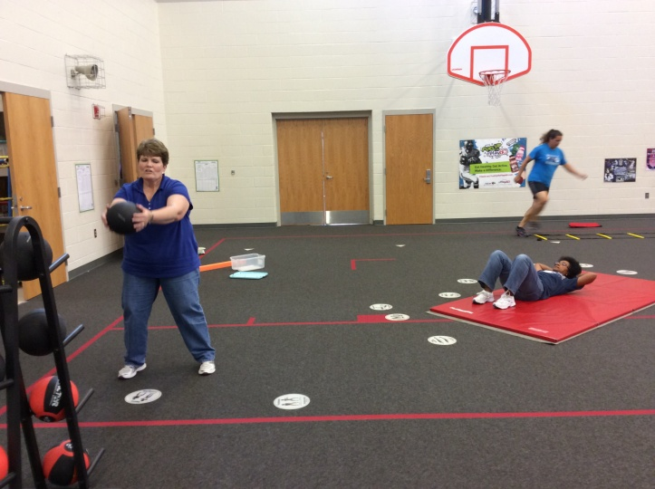
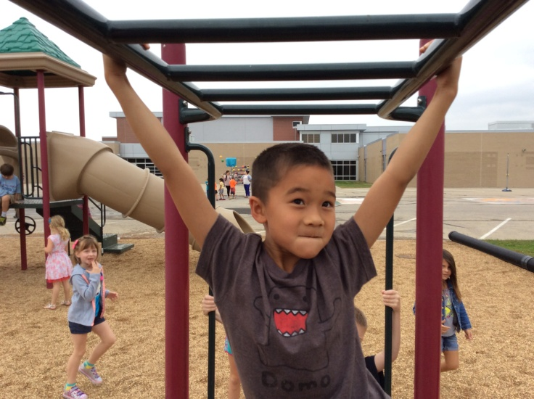
Fuel Up to Play with Let’s Move; Active Schools
Notes:
What is FUTP 60
Fuel Up to Play 60 uses the power of collaboration to help make everyone at the school healthier by fueling up with nutrient-rich foods and being active for at least 60 minutes a day. With Fuel Up to Play 60, students are empowered to make healthy decisions, take action for change and encourage their friends to do the same. Fuel Up to Play 60 complements other school wellness programs, and helps schools to meet their wellness goals.

Slide 4
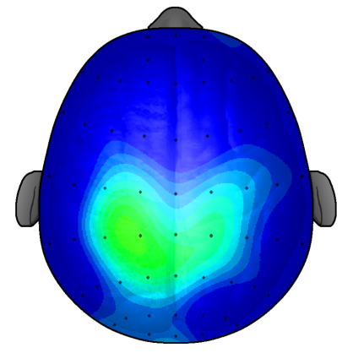
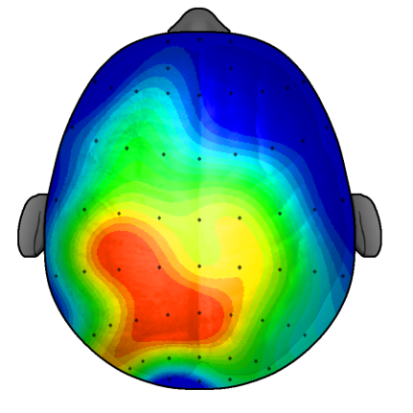
Fuel Up to Play with Let’s Move; Active Schools
After 20 minutes of sitting quietly
After a 20 minutes of walking
Notes:
Tara - This is a composite diagram of brain activity from 20 student brains taking the same test. The students who took the test after sitting quietly showed low to minimum brain activity. However, the students who took the test after a 20 minute walk exhibited mid to high brain activity. Additional research shows that when a body is inactive for 20 minutes or more, there is a decline in neural communication between the two hemispheres of the brain. Neural pathways fade when they are not in use. The conclusion is that brain hemispheres communicate more effectively and cognitive abilities are heightened when the brain is prepared for learning with physical activity. Therefore, to maximize brain function throughout the school day…
Physical Activity isn’t an option. It’s a necessity. Active kids do better.

Slide 5
Fuel Up to Play with Let’s Move; Active Schools
Brain BREAK
Amnesia
Notes:
LMAS CSAP slide
https://www.youtube.com/watch?v=AxeFpfVyycM&feature=youtu.be

Slide 6
6 Steps
Fuel Up to Play with Let’s Move; Active Schools
Notes:
Wendy 6 steps
Step 1- Join
Step 2- Team
Step 3 – Kickoff
Step 4- Survey the Field
Step 5 – Game Time
Step 6- Light Up the Score Board= Success Story

Slide 7
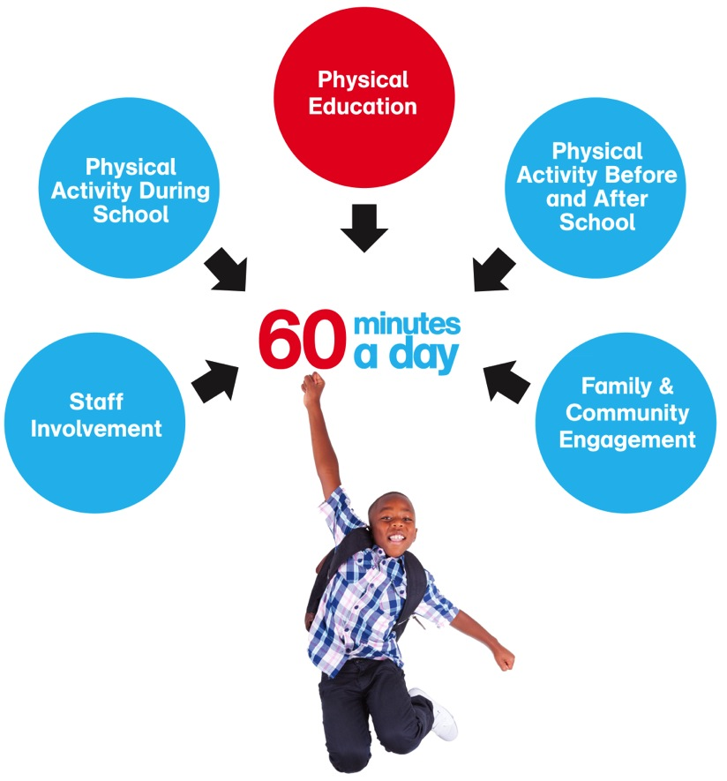
Comprehensive School Physical Activity Program (CSPAP)
Notes:
Tara The Let’s Move! Active Schools initiative seeks to provide 60 minutes of physical activity everyday for every child. If you want to become an Active School, the Comprehensive School Physical Activity Program (CSPAP) includes 5 key elements that can help you achieve school-wide change and provide the physical activity your students need.
CSPAP is focused first on Physical Education and then the other components – PhyscialActivity Before and After School, During the School Day, Family & community and Staff Involvement.

Slide 8
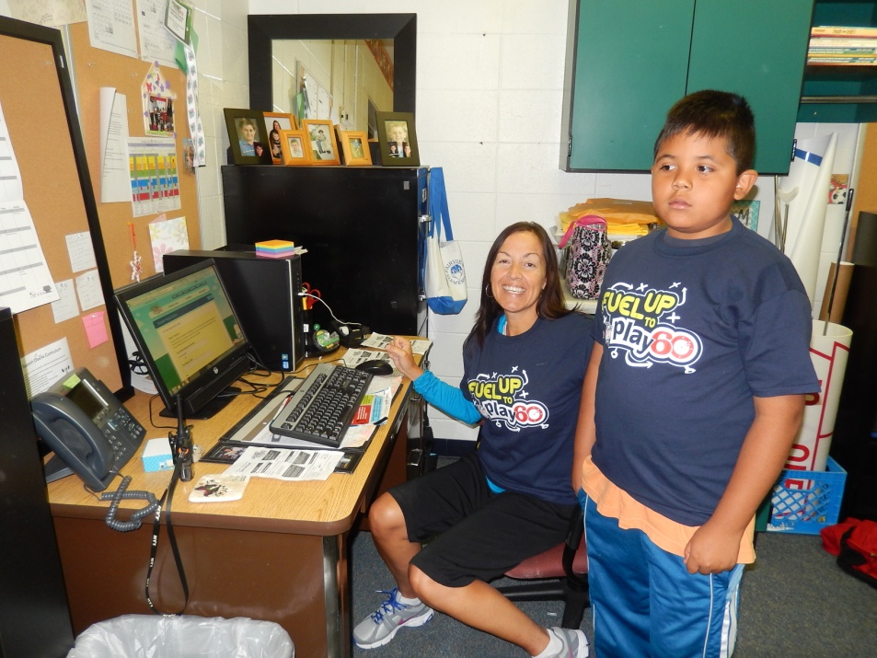
Join the Team
Fuel Up to Play with Let’s Move; Active Schools
Sign up
Become a Program Advisor
Lead students to make the school healthy and physically active
Notes:
Wendy Step 1
Supporting Research
Check out these resources to learn more about why nutrient-rich foods and physical activity are so important for students—and you! Why and How to Play 60 Health experts recommend that young people get at least 60 minutes of physical activity a day. Here's why and how to meet this goal!
What Foods Can Do For You Learn why your body loves nutrient-rich foods, and get information on how much of them you should choose each day. Put up information about the program and tell others that the school is working toward Touchdown Status.

Slide 9
Team
Fuel Up to Play with Let’s Move; Active Schools
Adults
Students
Parents
District
Notes:
Wendy and Tara Step 2- Team
Who do you have on a team?
Teachers
Students
Parents
District personnel
How do I pick a team?
Program Advisor picks
Teachers pick
Application process
How Many students on a team?
1-200
Core team – 6-10 students
What grades – elementary – 3-5, Middle school might be a club during the day
This year must have a student reach 20,000 points to have this step checked off.
How often and when does the team need to meet?
Before, during lunch, after school, as a club during the day or after
How often is up to you and how involved you want the kids to be. 1X a month or weekly

Slide 10
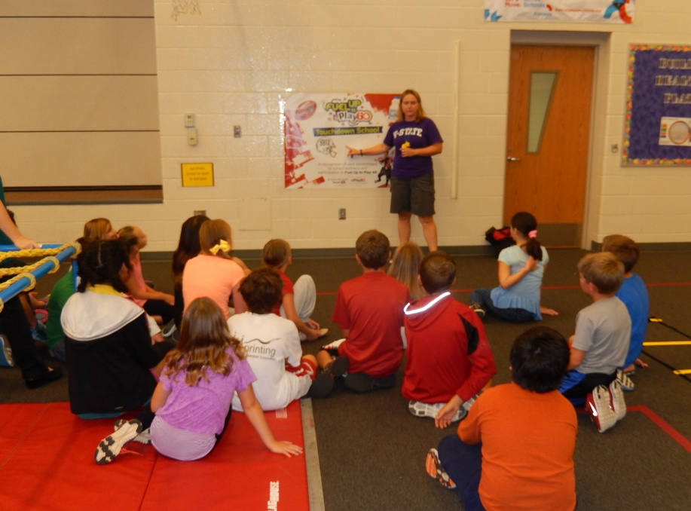
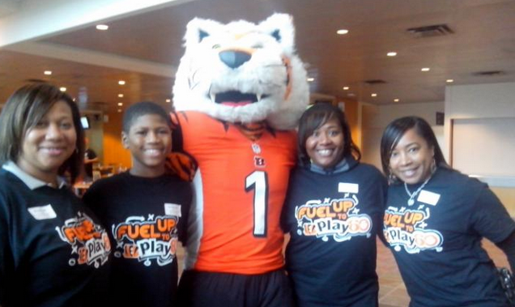
KICKOFF
Fuel Up to Play with Let’s Move; Active Schools
Notes:
Tara Step 3- Kickoff
The kickoff can be very creative from announcements in the morning to a BIG EVENT of some kind.
Tara – did the obstacle course that Olathe has (TARA – tell what you did)
Other ideas for kickoffs:
Announcements
Tie in with other activities that are planned such as: Walk & Bike to School Day, Fun(d) Raiser, evening event, School Pep Rally, Posters around school, during PE class, an assembly.

Slide 11
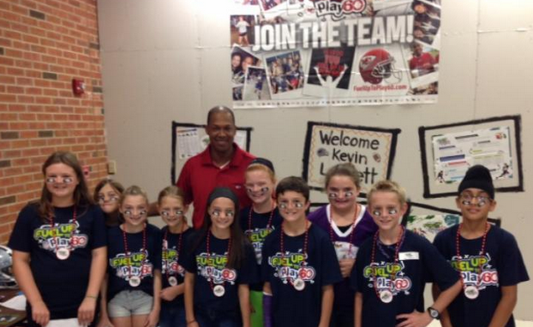
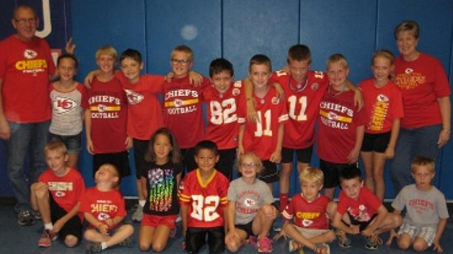
KICKOFF
Fuel Up to Play with Let’s Move; Active Schools
Notes:
Wendy - Meadowlane Elementary in Olathe goal was to kick-off the school year with a memorable assembly to get the kids excited about FUTP60. We invited Kevin Lockett (former KSU and Chiefs player) to talk at our assembly since he works right across the street from us. He accepted and did a great job talking about the importance of being active and healthy! The kids were pumped up! I can see the kids more excited about the program than before the assembly. More kids are signing up online and talking about Play 60. My leadership team (10 kids) ran the first part of the assembly - the welcome, a quiz with prizes, and some fun chants to get the crowd going. They also had the chance to meet with Lockett for a special moment before the assembly. Parents came to see the assembly as they were excited about Lockett. Staff members were supportive and allowed time for the kids to get ready for the assembly.
Briarwood Elementary used the season opener for the Kansas City Chiefs. We are increasing school spirit. Students wore Chiefs gear or red. Teachers and principal helped.

Slide 12
School Wellness Investigation
Fuel Up to Play with Let’s Move; Active Schools
Here the students are answering the questions on the School Wellness Investigation
Notes:
Wendy Step 4-
School Wellness Investigation is to help decide what plays a school might want to consider. It tells how well the school is doing using 3 areas: nutritional services, physical Education & physical activity and family & community involvement.
The School Wellness Investigation is a tool that will help you and your team members collect information about your school's current nutrition and physical activity environment.
Developed in alignment with authoritative guidelines, the School Wellness Investigation will identify opportunities to make your school′s wellness environment even better! Based on your answers, Fuel Up to Play 60 will provide you with a customized list of Plays to help your school get started
There are several ways to complete the SWI – 1st the Program Advisor will have to input all information gathered via the computer for this step to be checked off.
Ways to complete:
AS in the picture – with the core team
Dividing the core team into 3 groups, each group doing 1 of the components.
Program Advisor & 1 or 2 students doing it.

Slide 13
Fuel Up to Play with Let’s Move; Active Schools
Brain BREAK
Football Rock Paper Scissors
Notes:
LMAS CSAP slide
https://www.youtube.com/watch?v=AxeFpfVyycM&feature=youtu.be

Slide 14
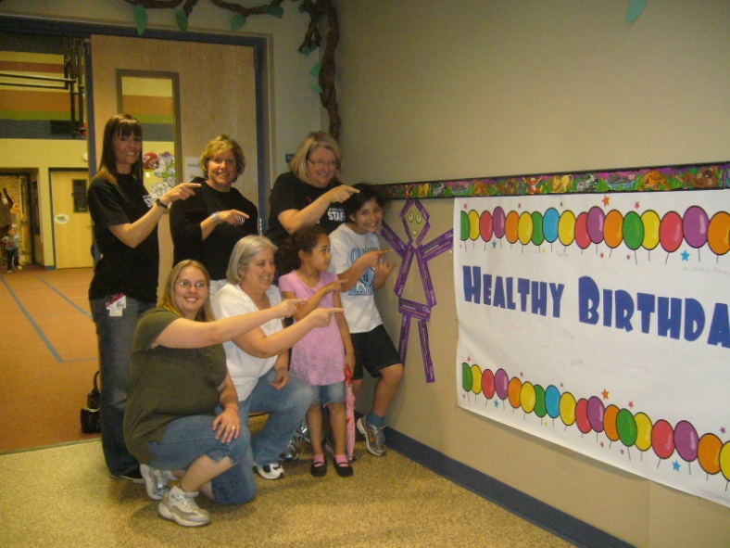
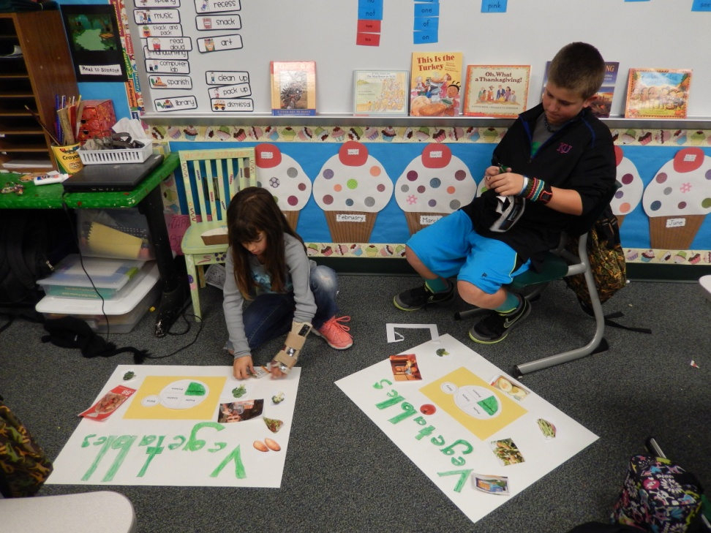
Healthy Eating Plays
Fuel Up to Play with Let’s Move; Active Schools
Healthy Birthday Club
Posters
Notes:
Wendy Step 5- Healthy Eating play
Healthy Birthday Club – Started at Woodland Elementary when they were a new school and I used it at RV when I was the PA. Students brought a healthy birthday treat for their class and the PA. Their name was read over the intercom, the student received a balloon to put on their chain and a name tag saying they where a healthy eater.
Eat Your Veggies or What’s Your favorite Veggie? – Forestview core team made posters and put them around the school – Each student had their picture on the poster they made along with their favorite vegetable.
Tara – HyVee Taste Testing Field Trip

Slide 15
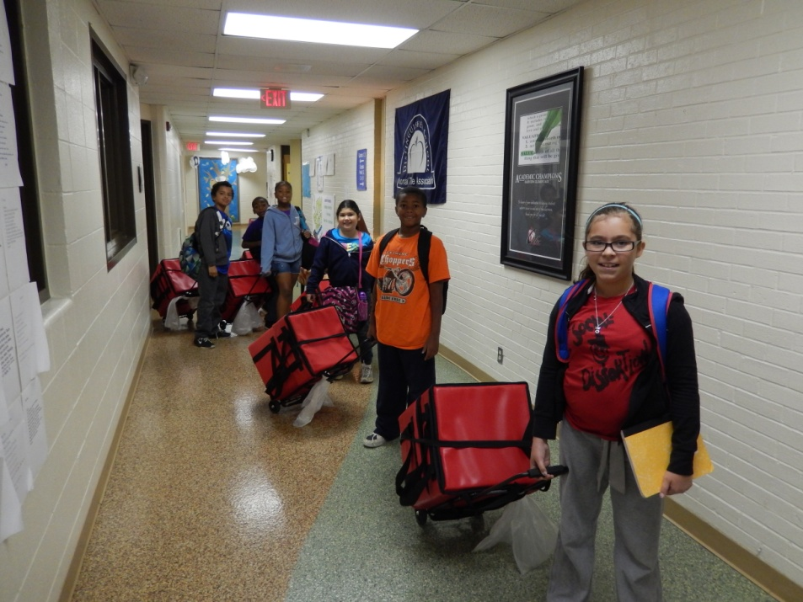
Healthy Eating Plays
Fuel Up to Play with Let’s Move; Active Schools
Breakfast in the Classroom
Field Kindley High (Coffeyville, KS)
Late Breakfast a Success at Field Kindley High
Notes:
Wendy Breakfast in the classroom – several school in Olathe have gone to having Breakfast in the classroom. In the slide here you see students even helping to bring the breakfast to the classroom
Field Kindley High School didn’t have a written story but the pictures I think as they say a picture is worth a thousand words. As the title states, Field Kindley High School has a late breakfast available for students. And as many of your may know, eating breakfast at school has been shown to help student learning some more than breakfast at home.

Slide 16
Healthy Eating Plays
Fuel Up to Play with Let’s Move; Active Schools
Milk Mustache
Grab And Go Breakfast- Anytime!
Healthy Breakfast, Healthy Lunch-BAR NONE
Promoting Healthful Choices
Snack Smarter at School
Notes:
Tara Read Slide- these are the 2014 Healthy Eating plays if you want to apply for funding that need to be used – not the milk mustache
Bring on Breakfast
Cafeteria Restyle
Try It, You’ll Like It
Get ready for the other part of step 5 by please standing up.

Slide 17
Physical Activity Plays
Fuel Up to Play with Let’s Move; Active Schools
Notes:
Tara In FUTP 60 the 5th step has physical activity plays – which we will do one right now
we need a Brain Break – please stand up
We are going to do a Jamin’ minute video made by students at Ridgeview Elementary.

Slide 18
2. PHYSICAL ACTIVITY DURING SCHOOL:
Integrating movement and academics
Physical Activity During School
Notes:
Tara
In LMAS there is the during the school physical activity which is one of the things we just did with the Brain Break. In order to ensure that every child receives 60 minutes of physical activity, it is essential that students are active throughout the school day. From the moment they enter the school doors to the time they leave, there are many opportunities for kids to be physically active. Not only will it help kids achieve the recommended amount of physical activity, integrating movement with academics will reinforce classroom content, and facilitate retention, concentration, and on-task behavior.
Who should be involved in ensuring physical activity during school? EVERYONE!
Physical educators
Classroom teachers
School staff
Parents & volunteers
Administrators

Slide 19
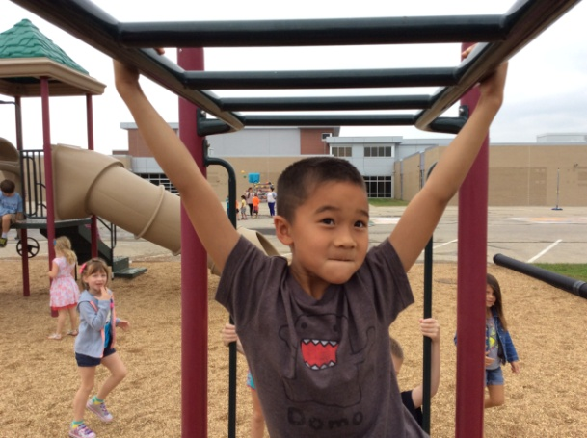
Physical Activity During School
Daily Recess
Activity Rooms
Drop-in” PA
PA Integration
Food Chain
Math
Quiz
Classroom PA Breaks
Other
Physical Activity During School
Notes:
Tara
Physical activity during school can be both structured and non-structured, and it can take place on the playground, the auditorium, the classroom or elsewhere.
Daily recess (NASPE, 2006) (Elementary/Middle):
More than 20 min.
Free play or semi-structured
With Active Supervision
Facility/Equipment needs:
Equipment bags
Painted playgrounds
Activity zones or stations
Activity rooms (stand-alone rooms with mats, balance boards, brain bikes, etc.) Whole classes or individual students can go to an activity room for:
Test preparation
Behavior management
“Drop-in” PA (secondary): open gym, pool, track, or weight room; scheduled aerobic classes, Frisbee golf
Lunch periods
Advisement
PA Integration: Using movement to reinforce classroom content (3 video examples)
Provides breaks from long bouts of sitting
Performed in limited space during natural class transitions
Improved time on task
Improved academic performance
Classroom PA Breaks (Jammin’ Minute video)
About 5-10 minutes in duration
Focuses on movement, not classroom content
Facilitates attentional reset
Helps students focus and reenergize
Fewer discipline issues
Examples of classroom PA breaks
Energizers
Activity cards (Pangrazi et al., 2009)
Lessons (Reed, 2010)
Take 10!
Jammin Minutes
Kagan strategies
Wall pushups
Toe touchdowns
Mingle-Mingle
Stand & stretch
Isometrics
Core exercises (e.g. planks)
Other
Active Academics: Some academic activities REQUIRE physical activity
Planting a school garden into elementary school activities can teach about nutrition while boosting physical activity and exercise.
A two-year Cornell University study of 12 elementary schools in New York state finds that children at schools with gardens were more physically active at school than before their schools had gardens. What's more, children who gardened at school were substantially less sedentary at home and elsewhere than their counterparts.
With nearly one in three American children overweight or obese, school gardens could be a simple, low-cost way to get kids more active (said environmental psychologist Nancy Wells, professor of design and environmental analysis in Cornell's College of Human Ecology).

Slide 20
Physical Activity Plays
Fuel Up to Play with Let’s Move; Active Schools
Notes:
Wendy
Step 5- Physical Activity play
Fairview Elementary did a play they called Workout Wednesday where the student team learned a dance to a specific song. After announcements classes went into the hallway with one of the core team members in each hallway to be the leader. Music played and they danced!!! I’m sure others of you have done something similar – Fitness Fridays, Moving Mondays (boy don’t we all need that after some weekends!)

Slide 21
Brain Breaks
Fuel Up to Play with Let’s Move; Active Schools
Notes:
Tara - Brain Breaks- during the day

Slide 22
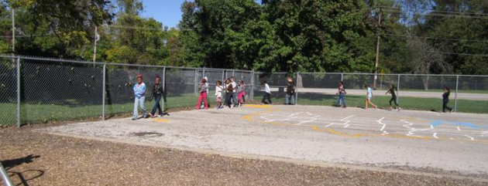
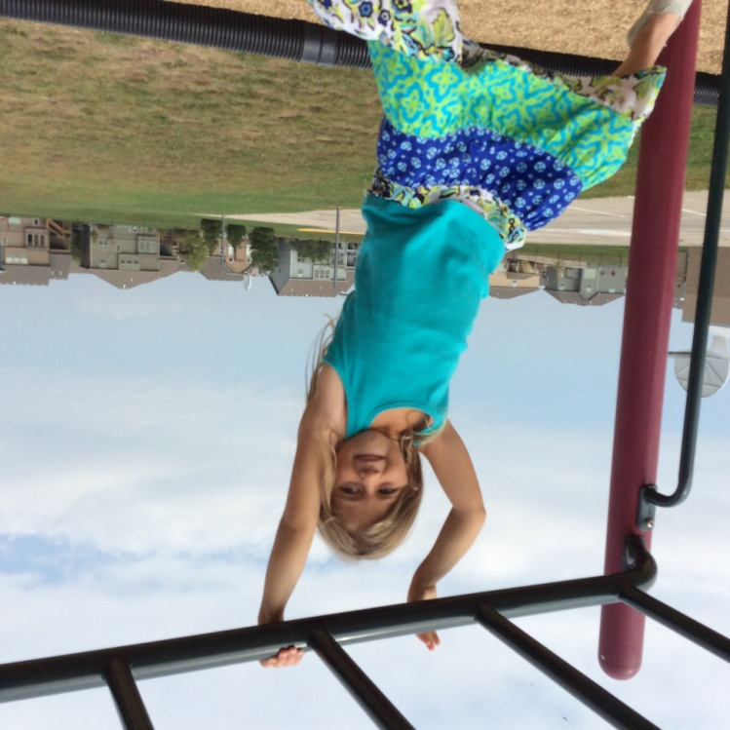
Ramp Up Recess
Fuel Up to Play with Let’s Move; Active Schools
Notes:
TARA - Tie into LMAS – Recess - during the day activity
Ramp Up Recess is one of the FUTP 60 Physical Activity Plays for this year. It is one that can be used to apply for funding – up to $4,000. There are some parameters with the funding – the Physical Activity play can’t ask for more than the Healthy Eating play .

Slide 23
Physical Activity Before and After School
Start-of-day movement
School-sponsored clubs
Open gym time
Active Transportation
Physical Activity Before and After School
Notes:
Tara
Before- and after-school physical activity offerings might include
Start-of-day movement - During announcements; “Channel One,” ACES (All Children Exercising Simultaneously)
School-sponsored Clubs - non-competitive physical activity clubs or intramural programs
Open gym time - informal recreation or play on school grounds, or physical activity in school-based child care programs.
Active Transportation - a walking and/or biking to school program. Examples (click Active Transportation for video):
Walk or bike to school:
www.walktoschool.org
www.saferoutesinfo.org
www.walkingschoolbus.org
Rails to Trails:
www.railstotrails.org

Slide 24
Fuel Up to Play with Let’s Move; Active Schools
100 Mile Club or Walking/Running Clubs
Notes:
Wendy 100 mile club – after school LMAS
At Ridgeview Elementary they walk outside in the morning until the bell rings to come in or if it is raining they meet in the gym and do dancing using U-Tube videos.

Slide 25
5. FAMILY AND COMMUNITY ENGAGEMENT: Ensuring a culture of physical activity
Family & Community Engagement
Notes:
Tara Physical activity should extend beyond the school day. Family and community engagement in school-based physical activity programs brings people together in a healthy way. Research shows that youth participation in physical activity is influenced by the participation and support of parents and siblings. When families are active together, they spend additional time together, experience health benefits, and ensure that their child enjoys a physically active culture both at school and at home. Parents, guardians or other family members can support a CSPAP by participating in evening or weekend special events, or by serving as physical education or physical activity volunteers.
Community involvement allows maximum use of school and community resources and creates a connection between school and community-based physical activity opportunities. Community organizations might provide programs before or after school or establish joint-use or share-use agreements with schools.

Slide 26
Family and Community Engagement
Family & Community Engagement
Family Events
Healthy Information and Tools
Notes:
Wendy
Family Events: Invite families to school; utilize school resources to promote physical activity
Zumba, bike, broccoli triathlon
Disco on the Drive – Dancing on the Blacktop
Family Fun Nights
Open gyms
Multigenerational nights (i.e., Grandparent PA)
School/Community Fun Runs
Field Days/Wellness Fairs
Activities should be less competitive and more focused on lifetime activities that can include families
Involve local wellness organizations
Provide healthy food options
Healthy information and tools: Give families and communities information and tools to support a healthy, active lifestyle
Monthly fitness calendars
Family nutrition plan
Fitness back packs
Directory of local physical activity venues (nature parks & trails, bowling alleys, skating rinks, recreation centers)

Slide 27
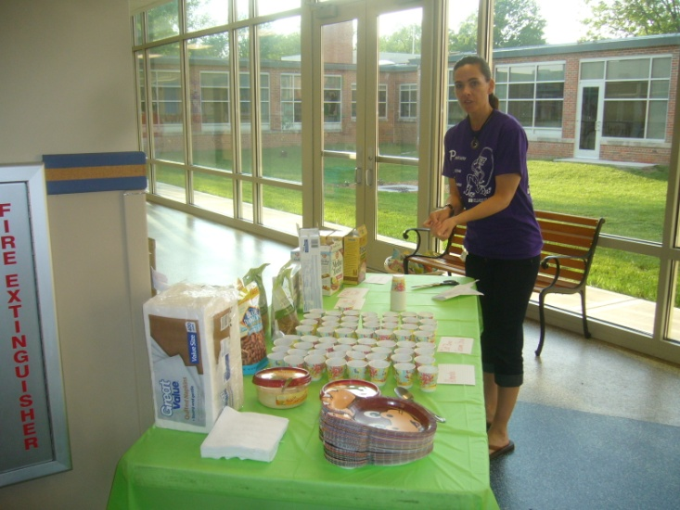
Family, Food, Fun Night
Fuel Up to Play with Let’s Move; Active Schools
Notes:
Wendy
Family Fun, Food – community
taste testing- which is a Healthy Eating Play in FUTP60
And they are doing several physical activities also.
The parents at this event went home and I actually had some students tell me that their parents were now playing more with them after school and on Saturdays.

Slide 28
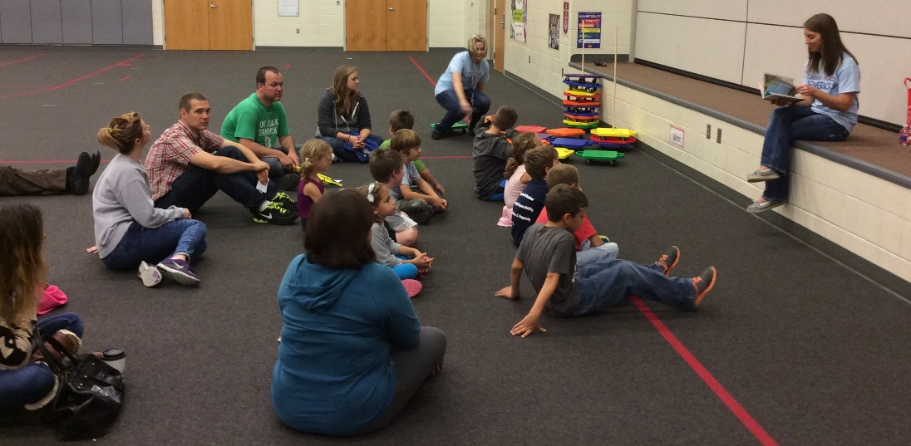
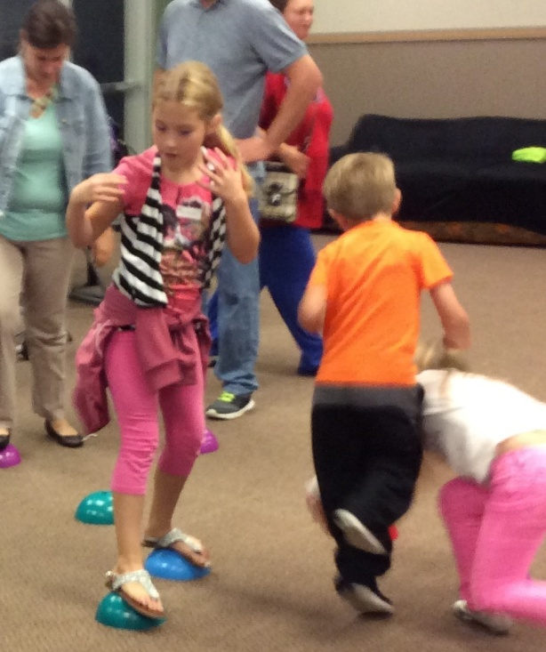
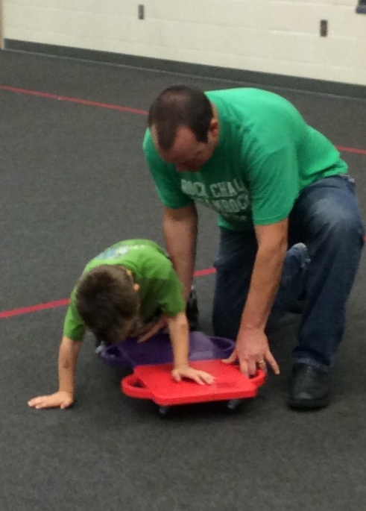
Read and Romp
Fuel Up to Play with Let’s Move; Active Schools
Notes:
TARA
READ and Romp- family activity

Slide 29
4. STAFF INVOLVEMENT:
Creating a healthy school Community
Staff Involvement
Notes:
Tara
School employees play an integral role in a school’s CSPAP BUT also in FUTP60. School-employee wellness programs improve staff health, increase physical activity levels, and are cost effective. When school staff commit to good health practices, they are positive role models for students by demonstrating active lifestyle choices in and out of school. Support for school-employee wellness contributes to the overall culture of physical activity at a school. Students see their teacher doing Brain Breaks with them and they usually get into the Brain Break with more gusto.

Slide 30
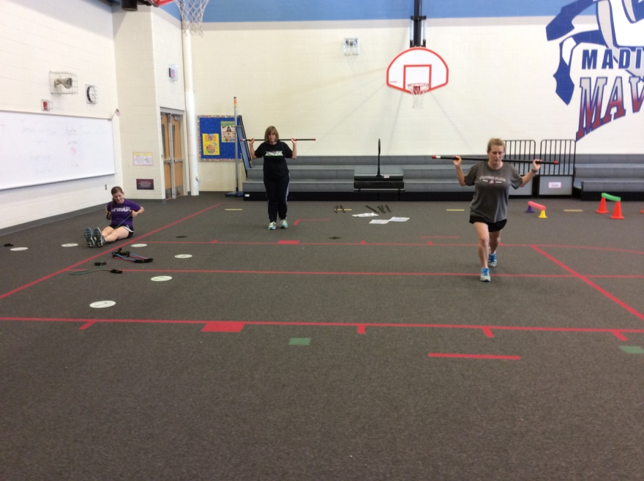
Staff Involvement
Fuel Up to Play with Let’s Move; Active Schools
Notes:
TARA: A part of LMAS deals with helping staff be involved. At Madison Place Tara & the nurse, Sarah, got together and started a staff……..

Slide 31
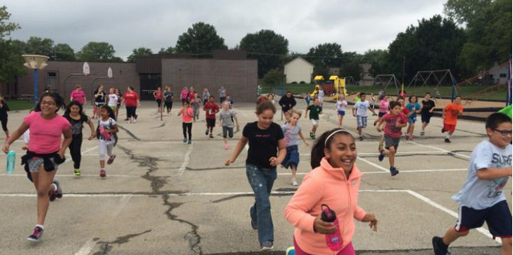
Fuel Up to Play with Let’s Move; Active Schools
Campaigns
For the Love of Play
Notes:
Wendy
Campaigns are also a part of FUTP60. Each semester the students are involved in a special activity – last year the Physical Activity was Make your Move – dancing of some sort and It starts with Breakfast as the Healthy Eating Campaign. This year it is For the Love of Play.
The students at Rolling Ridge Elementary School in Olathe, Kansas were excited to participate in the For the Love of Play campaign! For the Love of Play was something we wanted to start early. We wanted to get 50 or more 3-5 grade students involved with a Run Club that would meet every Thursday after school for a 2 mile run. We made announcements, posters, talked about how exercise helps keep you healthy in PE class. We ended up having around 80 participates. The number of kids that talk about how they enjoy running has increased a lot. Also, we have a huge number of these students that went on to do a 5K benefit run for another student in the district. They loved getting exercise and helping someone else out at the same time. The Fuel Up to Play 60 team made posters, and also lead the group in stretching before we started the run. We had many parents involved, many of which that would run with their child. Our principal, school nurse, and teachers from all the grade levels. It was a great success at Rolling Ridge Elementary School

Slide 32
Fuel Up to Play with Let’s Move; Active Schools
FUEL UP TO PLAY 60 - Mentors
Ernesto Alcantara – ealcantara@usd259.net
Jeff Arellano- jarellano@usd259.net
Cindy Johnson - Cjohnson8@usd259.net
Julie Webb - jwebbwl@olatheschools.org
Christina Murphy- cmurphyfv@olatheschools.org
Joan Bolt - jbolt@usd211.org
Notes:
Wendy
These 6 people have done FUTP60 and are willing to help mentor you IF you are not in an area where there are coaches.
Wendy is a Coach and helps the Program Advisor with questions and team meetings. Let’s us know when deadlines are for some fun things – like getting extra money because our school is a Touchdown school, Accomplished a set number of steps and could get more FUTP60 items for give aways like frisbees, pencils, step counters.
Please note on the card that has the mentors name and email that Ernesto’s needs to be changed… the a and l need to be switched.

Slide 33
Join today! Fueluptoplay60.com
Fuel Up to Play with Let’s Move; Active Schools
And
Let’s Move Active Schools
Physical Activity Leader –
(trainings available)
Notes:
Wendy
If you are interested in FUTP60 and you want to join… you can actually sign up today at the booth in the exhibit area or go to Fueluptoplay60.com
If you would be interested in becoming a Physical Activity Leader – where you have an action plan – which is what Tara is doing currently – you can ‘kill’ 2 birds with one physical activity play. The trainings are next summer, although if you would like to have some PALS come talk to your entire staff for 1 up to 3 hours as an inservice about LMAS I have a sign up here for both or either of these LMAS.

Slide 34
Questions?
Fuel Up to Play with Let’s Move; Active Schools
Notes:
If you are interested in FUTP60 and you want to join… you can actually sign up today at the booth in the exhibit area or go to Fueluptoplay60.com
How much time does it take to do this program?

